Slide 1
Gamified Learning for Rural Education
Design Thinking for innovation & Entrepreneurship (DTIE)
Section : 1
Project Batch-9A

Slide 2
Team Members – Group 9A
Jaya Haasika - 2620080077
Srisukta Hiranmayi - 2620030019
Akshitha Satwika - 2620030014
Sreemayi - 2620030390

Slide 3
Vision and Mission
Our Vision :
Bridge the learning poverty gap across 600,000+ Indian villages by making foundational literacy and numeracy as engaging as play.
Our Mission :
Deploy zero-data, multi-lingual gamified micro-modules on low-cost smartphones to boost retention and mastery by 3x by 2028.

Slide 4
Problem Statement
53% : Grade 5 rural students unable to read standard Grade 2 texts due to passive rote learning methods.
46.1% : Rural primary schools lacking stable internet connectivity, breaking online EdTech models.
35% : Unengaging traditional curriculum causes low motivation and high early school dropouts.

Slide 5
Research / Facts / Market & Industry Study
Market Overview: India Gamified EdTech market expanding from $50M in 2025 to $204M by 2031 (CAGR of 26.4%).
Key Points:
Addressable Rural Learners: 295 Million primary/secondary K-12 students.
Mobile-First Delivery Share: 73% market adoption in rural households.
National Mobile Connectivity Base: 969+ Million total internet subscriptions expanding digital reach.

Slide 6
Target User - Customer
Primary Learner : Age 6-12 · Rural Primary
Motivated by game quests, rewards, regional avatars, and instant visual feedback.
Rural Educator : Government School Teacher
Needs automated progress tracking and offline lesson assistance without technical complexity.

Slide 7
Competitors / Benchmarks
Some of the common benchmarks are:
• VidyaSetu: The leading benchmark for gamified user onboarding. Its landing page immediately pulls the user into a 5-second trial game before requiring registration, an approach highly effective for low-literacy or first-time digital users.
• Gimkit: Exceptional benchmarks for dashboard simplification. They showcase how game pin-codes and minimal text entry can instantly launch multiplayer or single-player educational modes.

Slide 8
Risks and Gap
Hardware Constraints: Outdated Android hardware with limited internal memory causing app crashes. Mitigation: Ultra-lightweight vector graphics engine maintaining build size under 15MB.
Teacher Resistance: Fear of digital replacement or lack of digital literacy among staff. Mitigation: Teacher co-pilot interface framing educators as quest masters.
Power Outages: Frequent power cuts interrupting daily school activity.
Mitigation: Instant auto-save state after every individual micro-quest module.

Slide 9
Concept/Idea/Prototype/Product/Solution
Our idea is to create a website that:
1. Works Without Internet : Students can share scores, badges, and progress with nearby classmates using simple device-to-device connections without needing internet.
2. Fun Math & Reading Games : Simple mini-games that automatically adjust difficulty—getting easier or harder based on how well the child answers.
3. Local Stories & Characters : Lessons designed using familiar village folk tales and regional stories so children connect with the content instantly.

Slide 10
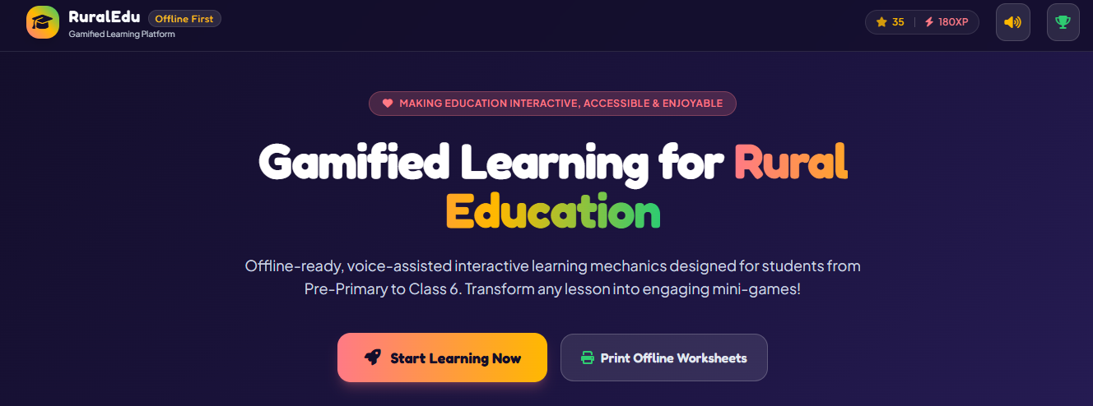
Images/Storyboard/Architecture
Local Wi-Fi Mesh: Zero-cost hotspot connecting student devices within classroom range.
Student Tablet App: Interactive game modules, badges, and adaptive practice.
Sync Dashboard: Weekly aggregate analytics sync when the teacher connects to a mobile network zone.

Slide 11
Lean Canvas Model
Problem: Low foundational literacy, high absenteeism, lack of rural connectivity.
Solution: Offline gamified learning application running on shared local school hardware.
Unique Value Proposition: Zero-data vernacular game loops boosting FLN retention by 3x.
Unfair Advantage: Proprietary lightweight mesh-sync protocol tailored for offline rural areas.
Customer Segments: State Education Departments, Rural NGOs, Corporate CSR Funds, Village Primary Schools.
Cost Structure: Vernacular Content Localization, Mobile App Engineering, School Hub Box Hardware.
Revenue Streams: Annual Per-School Licensing Model, NGO Deployment Grants, Government B2G Contracts.
Channel: Through offline platform with a gamified learning experience.

Slide 12
Capital (Financial)
Fund Deployment Breakdown:
App Engineering & Offline Mesh Protocol: 40%
Regional Content & 12 Vernacular Languages: 30%
Pilot School Field Deployment: 20%
Operations & Administration: 10%
Unit Economics per School:
Hardware Setup Cost: ₹4,500 / school
Annual SaaS Licensing Contract: ₹12,000 / year
Payback Period: 4.5 Months
Year 3 Projected Revenue: ₹1.8 Crore

Slide 13
Roadmap/Timeline
A realistic 12-month implementation roadmap for a rural-focused gamified learning web platform balances technical execution with community-driven validation. In low-resource settings, standard tech deployment timelines must lengthen to accommodate field trials, hardware compatibility syncs, and offline caching tests.
Phase 1: Research and Foundation
Phase 2: Prototype and Caching
Phase 3: Pilot trails and Translations
Phase 4: Production Launch

Slide 14
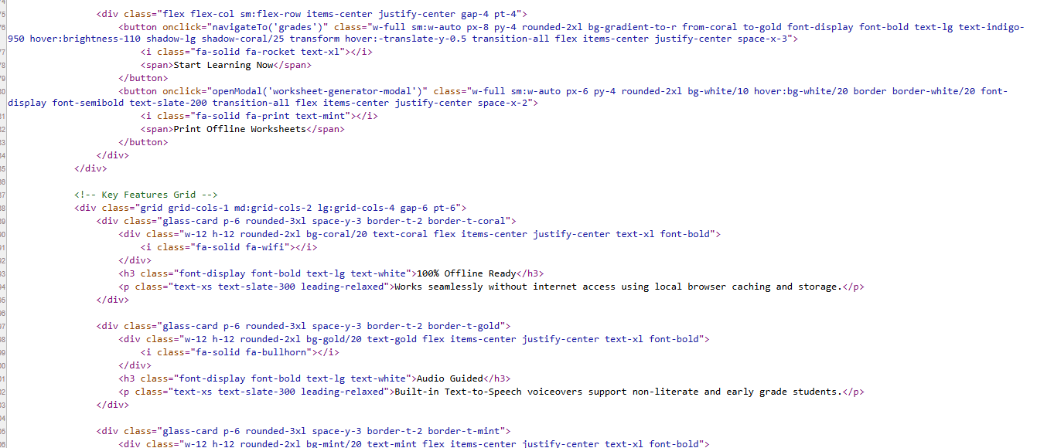
PROJECT CODE

